Slide 1

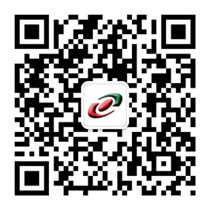
CHINA-ITALY CHAMBER OF COMMERCE
Introducing the MEWG
Mechanical Engineering Working Group
Suzhou
12 May 2017

Slide 2
“Mechanical Engineering” WORKING GROUP
Beijing • Shanghai • Suzhou • Guangzhou • Chongqing
Coordinator: Antonio Farese, MEC Co. Ltd.
Vice-coordinator: Mattia Lugli, Comer Industries Co. Ltd

Slide 3
MEWG, 2017 meetings
When:
01.06.2017 - Prima Power, 16:00-18:00
01.09.2017 - TBC, 16:00-18:00
24.11.2017 - TBC, 16:00-18:00

Slide 4
Introducing the MEWG, Mechanical Engineering Working Group of CCIC
PRELIMINART START-UP MEETING
Date : March 28, 2017
Venue : FAIST, Suzhou
The Mechanical Engineering Group will represent the interest of all Italian companies in China working directly or indirectly in the sector on a national base. Member of this group will share their experience and common issues to improve their knowledge on how to do business in China.
Agenda
identify and qualify all companies that could join the WG
- gather suggestions, ideas, proposal and activities for the annual plan of the WG
- identify and address the needs of sub-groups

Slide 5
Introducing the MEWG, Mechanical Engineering Working Group of CCIC
About the Mechanical Engineering WG
1. coordinate and address the needs of all Italian members in the different sectors of mechanical engineering in China (machinery, automotive, component manufacturers, mechanical engineering … )
2. promote and lobby the awareness of the size and quality of Italian technology to all institutions in China and Italy that are our natural counterparts, in order to develop business opportunities.
3. coordinate and promote the execution of activities and events that boost the visibility and image of “Technology Made in Italy”. The goal is to constantly modify the perception of the high level of Italian Technology with suitable activities and investments to increase the awareness of the Chinese audience.
4. inform members on Made in China 2025, opportunities and risks for Italian business
5. become a reference for all companies in mechanical engineering within the CICC lobbying private and public institutions active in the Chinese market.

Slide 6
OTHER INFORMATION
NEXT STEPS:
meeting agenda to be emailed before May 19th, 2017
collect inputs from members
identify and include more (proactive) members in the MEWG
collect data from reliable sources on I/E to China of the different kinds of products
prepare cases to support the MEWG activities and projects with relevant parties

Slide 7
Contact Information
Antonio Farese
CEO MEC Co. Ltd.
farese@cameraitacina.com
Mechanical Engineering Group Coordinator
Board Member of CICC
THANK YOU!

