Slide 1

CHINA-ITALY CHAMBER OF COMMERCE
2017 WORKING GROUP UPDATE
IV CICC Shanghai Members’ Meeting
12th May 2017

Slide 2
AAWG WORKING GROUP
Beijing • Shanghai • Suzhou • Guangzhou • Chongqing
Working Group Coordinator: Riccardo Coli
Working Group Vice-Coordinator: Angelo Cecchini

Slide 3
AAWG Projects & Updates
When:
May 12th 2017
Where:
Suzhou, Jiangsu Province, People’s Republic of China
What:
The AAWG represents the interest of all Italian companies in China working directly or indirectly in the aviation and aerospace sector on a national base. Members of this group work on defining, updating and taking part into the Working Group Program for increasing their knowledge and market share in the Chinese market.
Study and analyze the guidelines and policies of the Chinese central government with reference to the civil aviation, general aviation and aerospace industry.
Map and profile all of the Chinese aviation and aerospace players, manufacturers and decision-makers that are shaping the future of the domestic aviation industry.
Understand the global and local competition (at both government and private level) in order to profile how the other Countries are catching the opportunities.
Create and promote a brand/slogan to present the Italian companies in a unique and original way through a calendar of event and on-the-field activities.
Take part into international programs and lobbying activities

Slide 4
AAWG Targets
TARGET 1: AAWG SET-UP & MARKET POSITIONING
Position the AAWG into the actual/future Chinese aviation and aerospace industry.
AAWG Official Set-Up & Coordinator/Vice-Coordinator(s) Selection
AAWG Marketplace Understanding
  Where is China now?
  Who are the main players?
  Who are we competing against?
AAWG Brand Identity Creation
TARGET 2: AAWG MARKET APPROACH & PENETRATION
Promote the AAWG self-identity to present the Italian companies in a unique and original way through a calendar of events and on-the-field activities (conferences, workshops, business forums, etc.)
AAWG Communications’ Plan
AAWG Meetings, Events and Activities
  Self-organized
  Participant
TARGET 3: AAWG HIGH-LEVEL ACTIONS
Take part into international programs and lobbying activities, such as:
  Italy-China Aviation & Aerospace Cooperation Program (EMBASSY)
  EU-China Aviation Partnership Program (EUCCC)

Slide 5
AAWG Roles & Responsibilities (WG/Members)
WG
Inform its Members about the literature and information material
Interact and coordinate with Italian, European and Chinese Institutions
  Embassy of Italy to the People’s Republic of China
  Italian Trade Commission
  Confindustria
  Chinese Ministries
  Chinese Government Bureaus
  European and Chinese Aviation Authorities
Find and achieve cooperation with parallel entities and programs
  OBOR Program
  Other CICC WGs
  Industria 4.0
  EuSME Center
  International Chamber of Commerce
Serve, drive and lead the WG Program & Targets based on its’ members direct contribution
Create and present a Position Paper (PP)
MEMBERS
Actively cooperate to create, update and deliver the WG Program & Targets
Contribute in creating, developing and updating the Position Paper
Promote the WG interests among new potential members and personal networks
Present and carry on ideas, feasibilities and deliverables for the WG
Share news and ideas on CICC AAWG WeChat Group

Slide 6
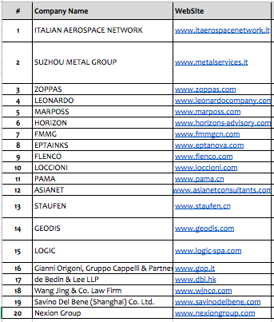
AAWG Updates (1): AAWG Members

Slide 7
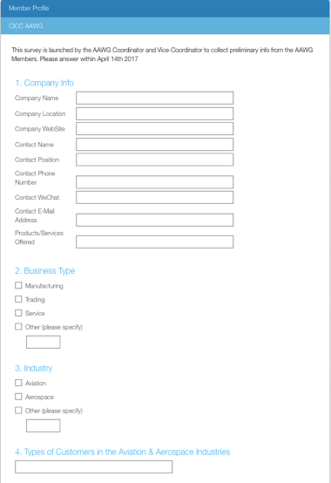
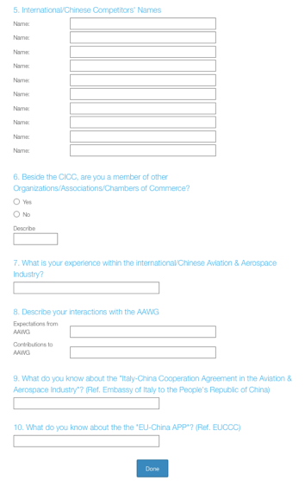
AAWG Updates (2): AAWG Members’ Profile
First Update:
Created an on-line survey to collect the following info from Members:
Company Info
Business Type
Industry
Types of Customers
Competitors
Other Member’s memberships
Level of experience in A&A
Expected interactions with AAWG
Level of knowledge in the Italy-China Cooperation Agreement
Level of knowledge in the EU-China APP
Results:
A total number of 10 Members have completed the Survey so far.

Slide 8
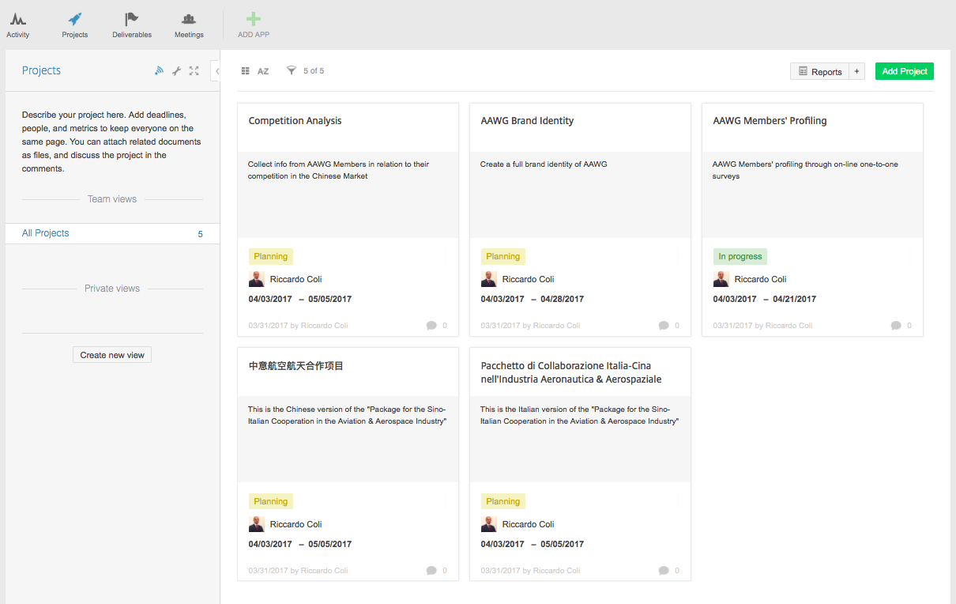
AAWG Updates (3): AAWG Platform – Projects
Second Update/A:
Created an on-line platform for those Members that have completed the On-Line Survey.
A tool to stay connected, share useful documents and updates, contribute and gain knowledge.
Results/A:
The AAWG Platform is divided into different parts. The first part is named “Projects” and at the moment it includes:
AAWG Members’ Profiling
Competition Analysis
AAWG Brand Identity
Italy-China Cooperation Agreement (in Italian language)
Italy-China Cooperation Agreement (in Chinese language)
Further AAWG Projects will be created into the AAWG Platform.

Slide 9
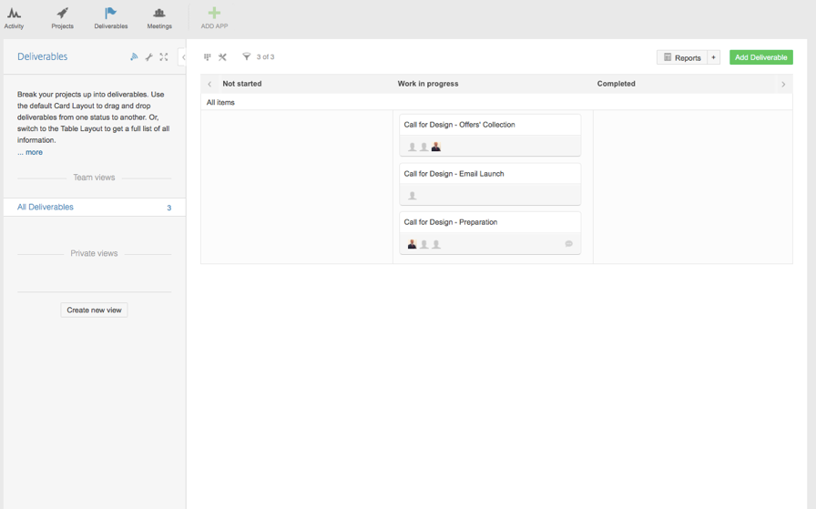
AAWG Updates (4): AAWG Platform – Deliverables
Second Update/B:
The second part of the AAWG Platform is called “Deliverables”.
Results/B:
All of the different deliverables are collected here. At the moment the following deliverables are listed:
Call for Design – Preparation (done)
Call for Design – Launch (done)
Call for Design – Offer Collection (TBA)

Slide 10
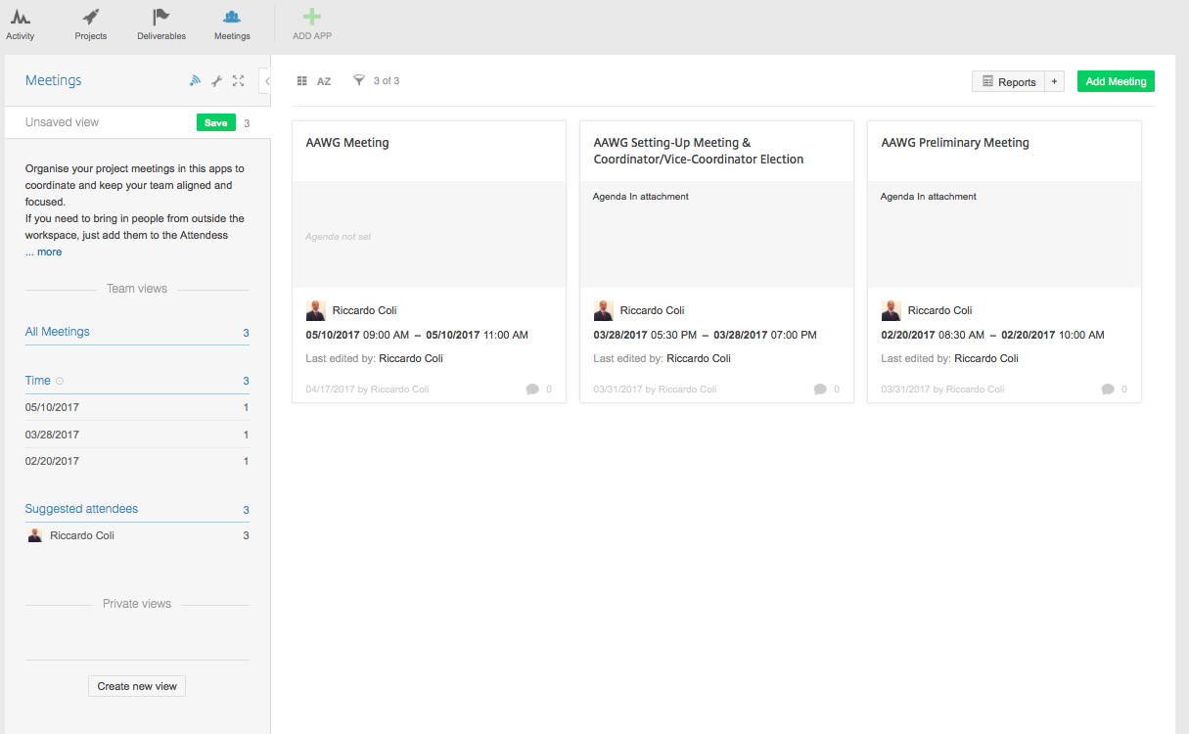
AAWG Updates (5): AAWG Platform – Meetings
Second Update/C:
The third part of the AAWG platform includes the calendar of the activities and the meetings’ minutes.
Results/C:
At the moment the following activities have been created into this third part of the AAWG Platform:
AAWG Preliminary Meeting (02/20/2017)
AAWG Setting-Up Meeting (03/28/2017)
AAWG Meeting (10/05/2017)

Slide 11
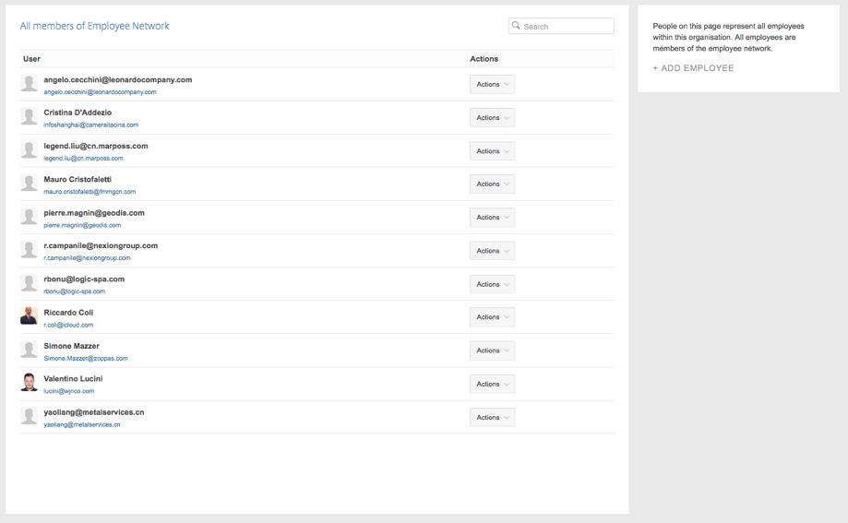
AAWG Updates (6): AAWG Platform – Network
Second Update/D:
The fourth part of the AAWG platform includes the list of members’ who joined the AAWG Platform.
Results/D:
At the moment the following Members have joined the AAWG Platform:
Riccardo Coli
Angelo Cecchini
Cristina D’Addezio
Legend Liu
Mauro Cristofaletti
Pierre Magnin
Riccardo Campanile
Raimondo Bonu
Simone Mazzer
Valentino Lucini
Yao Liang
One person per company can join the AAWG Platform, due to platform’s constraints.

Slide 12
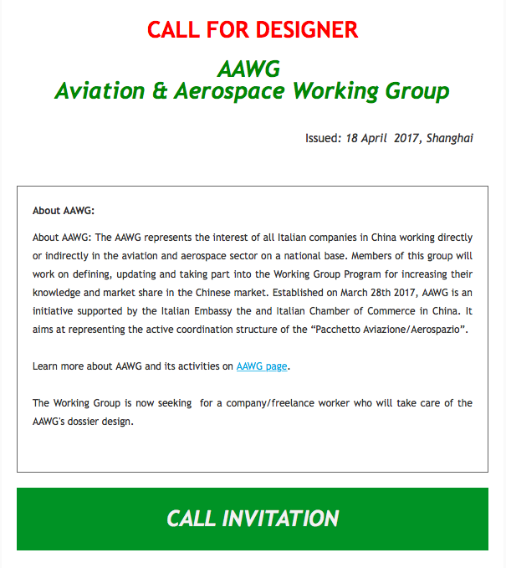
AAWG Projects (1): Brand Identity
To collect proposals from designers the following schedule was drafted:
Call for Design Proposals – Preparation
  April 17th 2017
Call for Design Proposals – Launch
  April 20th 2017
Call for Design Proposals – Collection
  May 5th 2017
Call for Design Proposals – Proposals analysis and discussion
  May 30th 2017
Call for Design Proposals – Closing
  May 31st 2017
Note: In case of no-offer-received the AAWG Brand Identity will be created by the AAWG Members or by any other appointed designer/design company.

Slide 13

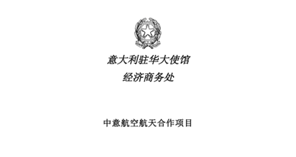
AAWG Projects (2): China-Italy Cooperation Program
Object of Internal Discussion
  Italian Version
  Chinese Version
Deliverables
  Update, edit, amend and integrate the documentation;
  Documentation analysis with Embassy of Italy to finalize it;
  Use it during next CICC Meetings, China-Italy Business Forums, etc.
Desired Outputs
  An extended version in both Italian and Chinese language
  A leaflet/booklet (short version)
Call for Contribution (Internal Assignments)
  Introduction → Ch. 1
  Chinese Aviation & Aerospace Industry → Ch. 2 Par 1
  The Chinese General and Business Aviation → Ch. 2 Par 2
  Italian Aviation & Aerospace Industry (CICC AAWG) → Ch. 2 Par 3
  China-Italy Cooperation Model (CICC AAWG) → Ch. 5
  China-Italy Cooperation Agreements (CICC AAWG) → Ch. 6
  Conclusions → Ch. 7
  Companies’ List (CICC AAWG) → Ch. 8
Next Steps definition

Slide 14

AAWG Projects (3): EU-China APP
  EU-China APP Introduction
  EUCCC-CICC (AAWG) relation creation/development
  Higher contribution/participation of CICC Members into EUCCC

Slide 15
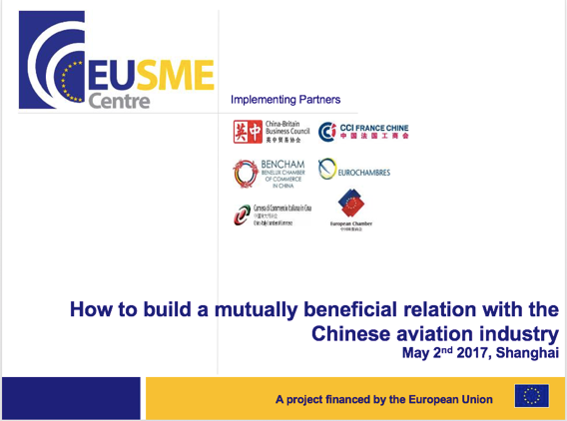
AAWG Projects (4): EU-SME Centre
CICC AAWG created an immediate positive connection with the EU SME Centre:
EU SME Centre-CICC Interaction;
Gain visibility among EU companies/Chambers of Commerce;
Promote “Italian Best Practices”;
Find EU-financed projects.
In June 2017, the CICC AAWG Coordinator will host a webinar on “How to build a mutually beneficial relation with Chinese Aviation industry”.
Final presentation will be available shortly.

Slide 16
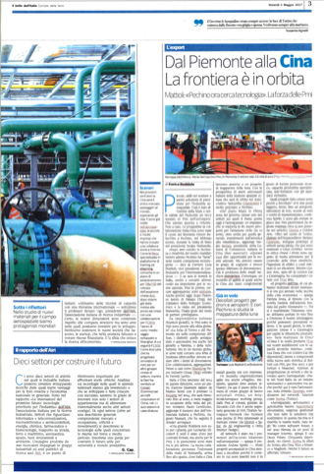
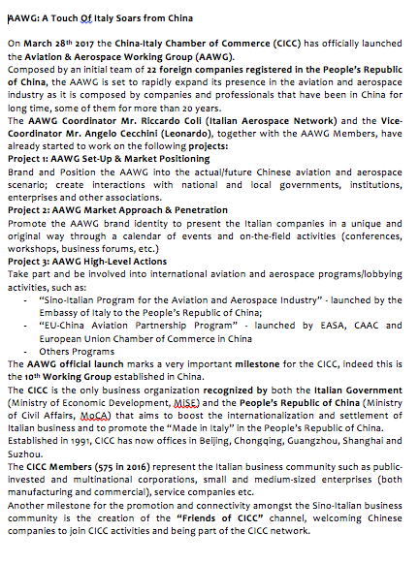
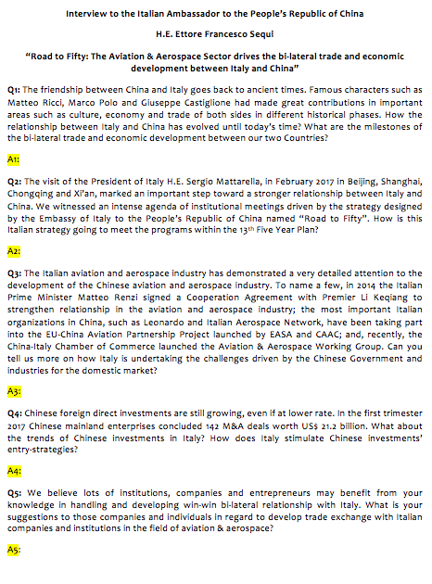
AAWG Projects (5): AAWG Communication Plan
Il Bello Dell’Italia: “Dal Piemonte alla Cina, La Frontiera e’ in Oribita”
Corriere della Sera, 5 maggio 2017
AAWG: “A Touch Of Italy Soars from China”
China Aviation News
Interview to the Italian Ambassador to the People’s Republic of China, H.E. Ettore F. Sequi:
“Road to Fifty: the Aviation & Aerospace Industry drives the bi-lateral trade and economic development between Italy and China”
China General Aviation Digest

Slide 17
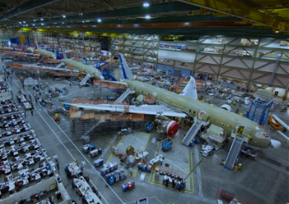
AAWG Projects (6): AAWG Members’ Visit
To know each other better, the CICC AAWG Coordinator/Vice-Coordinator will visit its Members.
In order to create a better relation between the AAWG and its Members, an agenda will be drafted for the Coordinator/Vice-Coordinator and the CICC to visit the AAWG Members.
We believe to know each other better will create more opportunities for internal cooperation and natural growth of both the AAWG itself and its Members in China.

Slide 18

AAWG Projects (7): AAWG Institutional Programs
AAWG intends to present itself to institutions in EU and Italy to become the representative of a funded-project.
Desire of knowledge, creation of new opportunities and a strong local presence of the CICC AAWG put the basis to cooperate on EU/IT-funded projects that can be developed in China.
Contribution by AAWG Members, in this way, will return in visibility, connections and further business opportunities.

Slide 19

AAWG Projects (8): AAWG Events
As the AAWG takes shape and expand its presence throughout the Chinese aviation and aerospace industry, we hold communications with ITA to exhibit at the upcoming China Aviation Expo, in Beijing.
The China Aviation Expo is one of the major events AAWG should take part to, to create further interactions and create business opportunities for its Members.
Interested companies can contact the AAWG Coordinator/Vice-Coordinator and CICC Staff to get more information.

Slide 20

Contact Information
Riccardo Coli
+86.13918344597
riccardo.coli@itaerospacenetwork.it
THANK YOU!
FOLLOW US ON WECHAT!

